Slide 1
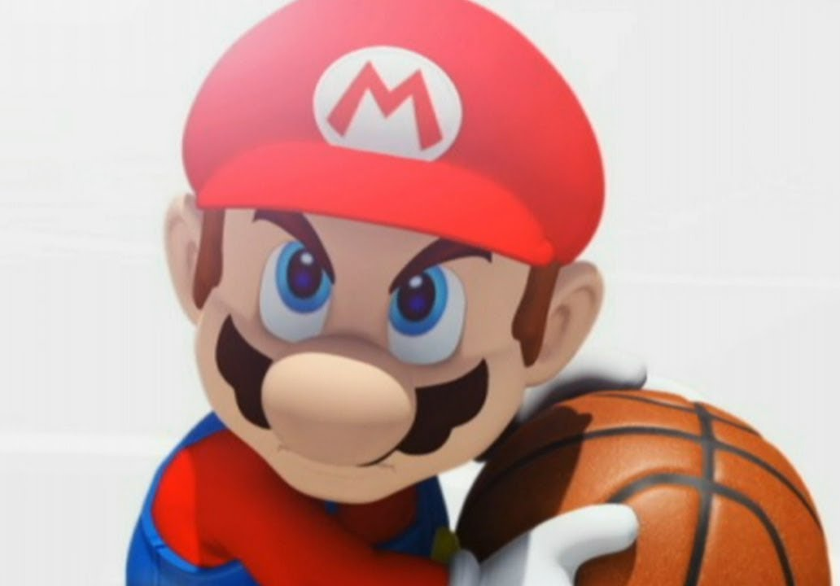

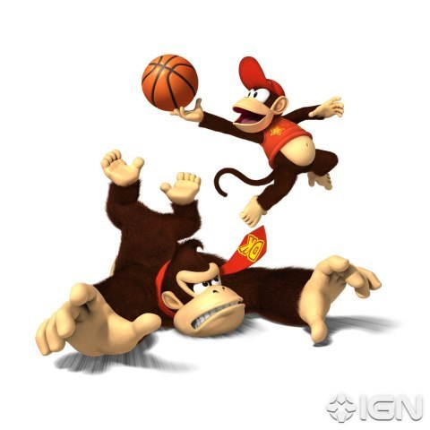
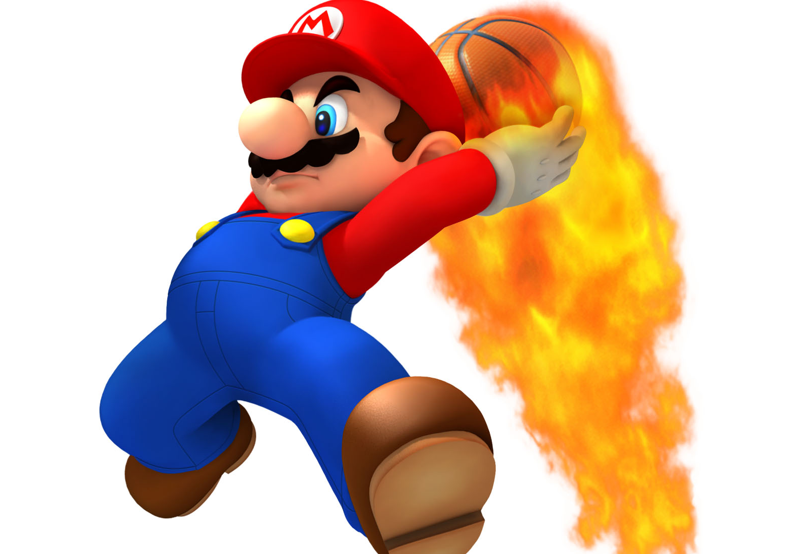
Basketball VI
Produced by Dr. Mario
UNC STOR 538

Slide 2
End-Game Strategy
Focus on Two End-Game Situations
Situation 1
Your Team Has the Ball With 5 Seconds Left and Losing by 2 Points
Should You Attempt 2-Point Shot to Tie or 3-Point Shot to Win?
Example: Philadelphia Versus Indiana in 2001 Playoffs (Game 1)
Situation 2
Your Team is Defending With 5 Seconds Left and Winning by 3 Points
Should You Foul or Allow Opponent to Attempt a 3-Pointer for the Tie?
Example: Dallas Versus Phoenix in 2005 Playoffs (Game 6)
Actual Outcomes
Situation 1: Reggie Miller Won Game with 3-Pointer at Buzzer to Win
Situation 2: Steve Nash Tied the Game with 3-Pointer and Later Won the Game after a Double Overtime

Slide 3
End-Game Strategy
Decision Making for Situation 1
Goal: Make Decision that Maximizes Probability of Winning
Two Assumptions
Other Team Will Not Foul on Shot
Game Will End on Our Shot
Important Events
A = Event that a 2-Pointer is Good
B = Event that a 3-Pointer is Good
C = Event that We Win in Overtime
W = Event We Win the Game
L = Event We Lose the Game
Probabilities Based on Data Over Many Seasons
If Attempting 2-Pointer, We Win if Shot is Made and Win in Overtime
If Attempting 3-Pointer, We Win if Shot is Made
$P\left(A\right)=0.52$ $P\left(B\right)=0.36$ $P\left(C\right)≈0.5$

Slide 4
End-Game Strategy
Decision Making for Situation 1
Decision Tree
Find Probabilities By Multiplying Across Branches
0.5
W
0.52
Made
L
0.5
2-Pointer
Missed (L)
0.48
0.36
Made
(W)
3-Pointer
Missed (L)
0.64

Slide 5
End-Game Strategy
Decision Making for Situation 1
Probability of W Given Attempting 2-Pointer
Probability of W Given Attempting 3-Pointer
Reality: Most Coaches Will Go for 2-Pointer Due to Perceived Risk
Conclusion: Always Go For 3-Pointer.
Sensitivity Analysis (Cases Where 2-Point Attempt is Better)
Suppose We Have a Play That Scores a 2-Pointer 80% of the Time
Suppose Our Best 3-Point Shooter Scores a 3-Pointer 20% of the Time
$$P\left(W|Attempt 2−Pointer\right)=P\left(A\right)×P\left(C\right)=0.52×0.5=0.26$$
$$P\left(W|Attempt 3−Pointer\right)=P\left(B\right)=0.36$$
$$P\left(W|Attempt 2−Pointer\right)=P\left(A\right)×P\left(C\right)=0.8×0.5=0.4$$
$$P\left(W|Attempt 3−Pointer\right)=P\left(B\right)=0.20$$

Slide 6
End-Game Strategy
Decision Making for Situation 1
Decision Tree 2.0
x
W
0.52
Made
L
a
1-x
2-Pointer
Missed (L)
0.48
Play
Called
0.36
Made
(W)
b
3-Pointer
1-a-b
Missed (L)
0.64
W
x
W
Neither
L
Tie
L
1-x

Slide 7
End-Game Strategy
Decision Making for Situation 2
Two Researchers Concluded Defensive Team Should Foul
Adrian Lawhorn (Contributor to Hoops Habit)
David Annis (Statistical Consultant in Charlotte)
Based on Annis Lawhorn
Assume Last Possession
Within 11 Seconds, Offensive Teams Scored 3-Pointers 20% of the Time
If Defensive Team Fouls, Offensive Team Must Intentionally Miss a Free Throw
Probability Other Team Wins Off 2 Pointer
Probability Other Team Wins Off 3 Pointer
$$P\left(Other Team Wins|You Don^{′}t Foul\right)=0.2×0.5=0.1$$
$$P\left(Other Team Wins|You Foul\right)=0.77×0.14×0.46∗0.5$$
$$=0.025$$
$$P\left(Other Team Wins|You Foul\right)=0.77×0.14×0.3=0.03$$

Slide 8
End-Game Strategy
Decision Making for Situation 2
32 Games where Team Trailed by 3 Points and Leading Team Fouled
Bad Assumption Because Multiple Possessions Possible
Historical Aggregation Shows Probability of Winning Higher if Leading Team Doesn’t Foul (2005-2008)
$$\frac{7 Ties}{32 Games}=21.9\% (±14.6\%)$$
Scenario | Sample Size | Probability Leading Team Wins | 95% CI
Close Game Where Leading Team Didn’t Foul | 260 | 91.9% | (88.5%, 95.2%)
Close Game Where Leading Team Did Foul | 27 | 88.9% | (76.8%, 100%)
95% Confidence Interval for Proportion: $\hat{p}±2\sqrt{\frac{\hat{p}(1−\hat{p})}{n}}$

Slide 9
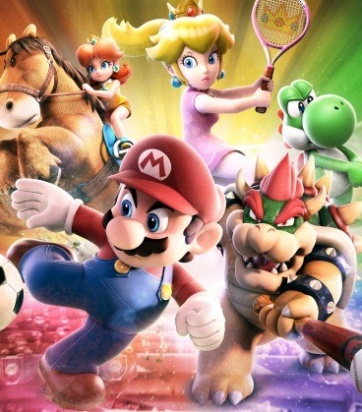
Final Inspiration
I cannot dunk a basketball,
but I can Dunkin’ Donuts.
- Mahatma Mario

